Slide 1
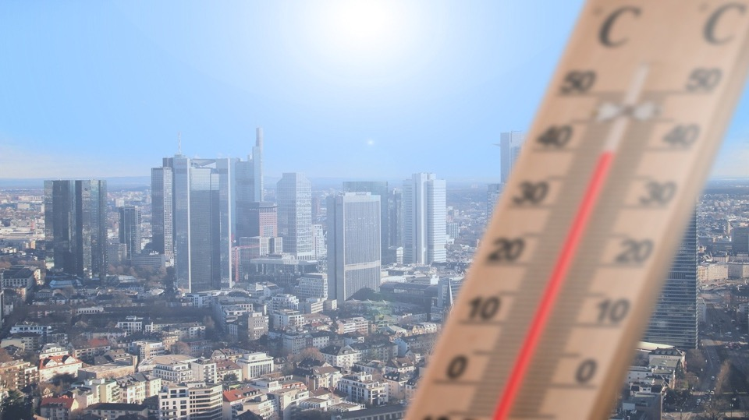
NOAA’s Communications Plan
2021 Urban Heat Island Campaigns
Alison Stevens, NOAA Climate Program Office
alison.stevens@noaa.gov

Slide 2
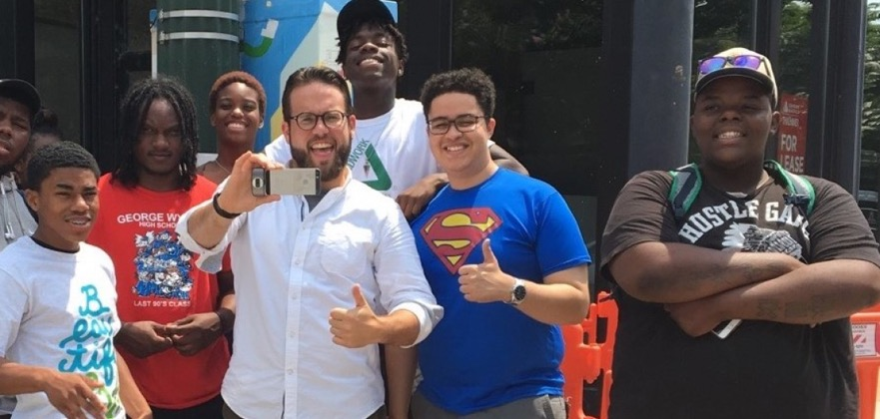
Press release - April 14th
Citizen Science Month

Slide 3
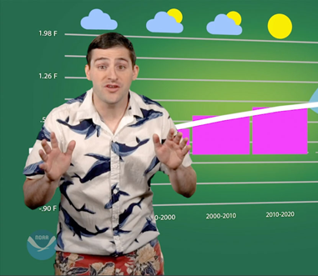
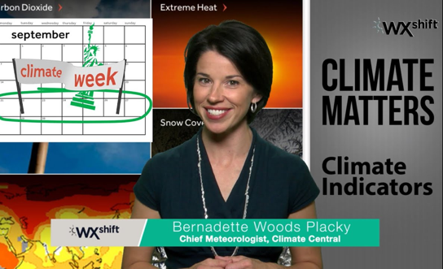
Media Roundtable - April 14th
Hosts: Tom Di Liberto (NOAA) & Bernadette Woods Placky (Climate Central)

Slide 4


Social Media Takeover
@NOAAClimate
94,000+ followers
@noaaclimate
46,900+ followers

Slide 5
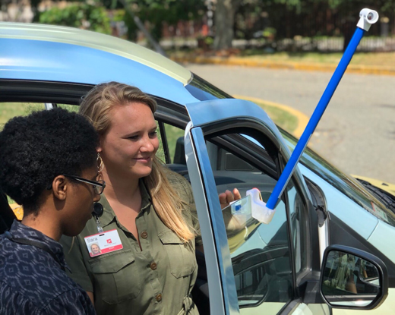
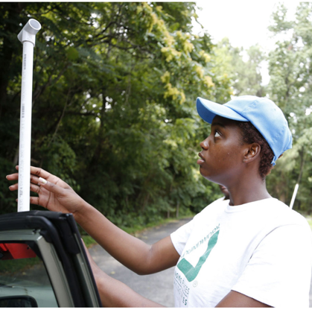
Profile on campaign volunteer(s)
Current and past cohorts

Slide 6
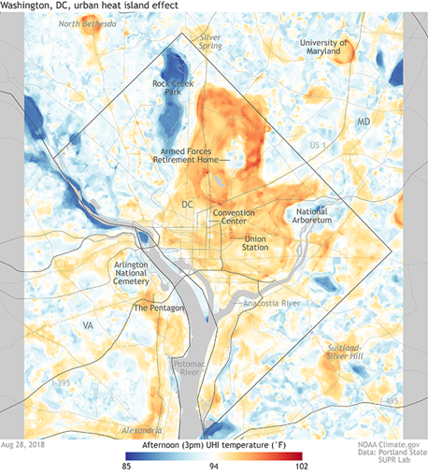
Next steps
Share roll out plan with your communications contact
Send us your social media handles
Contact:
Alison Stevens alison.stevens@noaa.gov

